Slide 1
Visualization Overview
An overview for getting started visualizing data
Dan Kern & Oliver Eichstedt
Created June 2019

Slide 2
Introduction
Visualizing data is an important part of conveying a message
Visualization allows to condense large amount of data and display it via a picture (vs. aggregate numbers)
Visualizations should keep the audience in mind
Presenter should convey the message without misleading the audience
Small “tweaks” can make BIG differences!

Slide 3

Why do we visualize data?

Slide 4
Definition
Data visualization is the discipline of trying to understand data by placing it in a visual context so that patterns, trends and correlations that might not otherwise be detected can be exposed.

Slide 5
Considerations
Type of data
Audience
Delivery format

Slide 6
Consideration: Type of data
Data
Continuous vs. discrete
Over time vs. “snapshot”
Singe vs. multiple groups

Slide 7
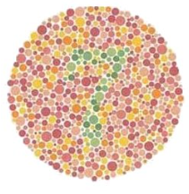
Consideration: Audience
Experts vs. novices
How much time do you have with the audience?
Gender: 10% of males are color blind while only 1% of women are (color blind palettes are available http://mkweb.bcgsc.ca/colorblind/)
What do you see in the image to the left?
Source: https://colormax.org/color-blind-test/

Slide 8
Consideration: Delivery format
Projection | Online | Print
Use easy to see visualizations Use a suitable size font Can the slides be viewed from an angle? | Consider the file size because it affects download time Use a suitable resolution (72 pixels per inch) Different monitors will display colors slightly differently | Will you print the material or rely on the reader to print it? Will the reader use a color or black & white printer? Consider the size of the visualization so it fits on a printed page Use a suitable resolution (300 pixels per inch)

Slide 9
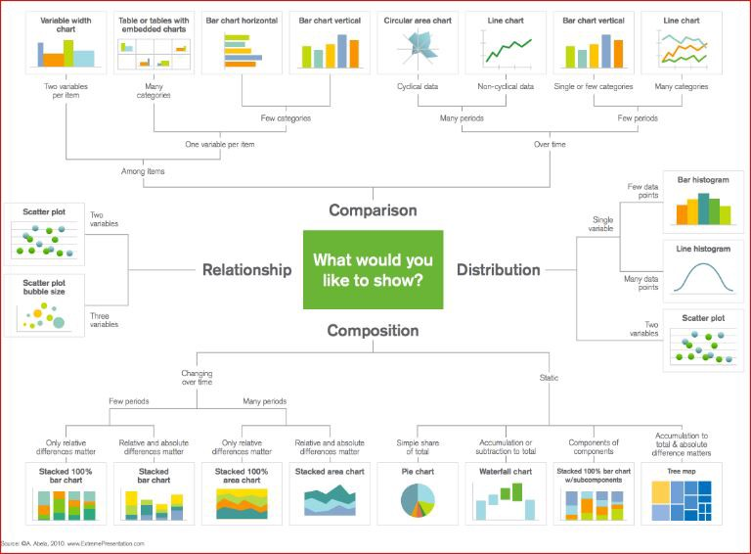
Charts: Types of Charts

Slide 10
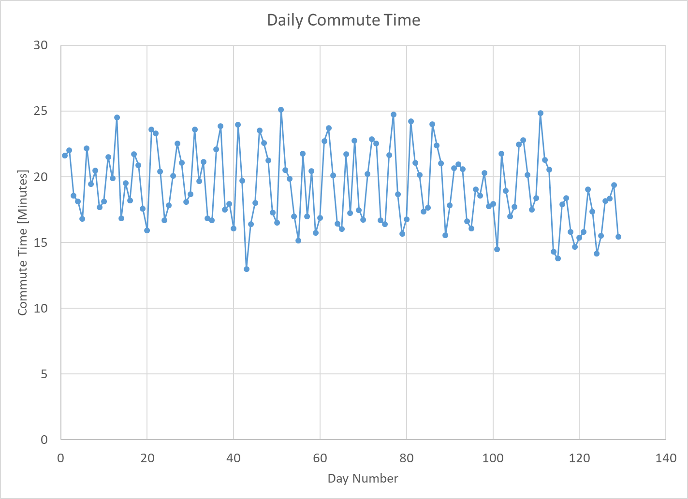
Parts of a chart
Chart title
y-axis
Chart area
Data points
Axis labels
x-axis
Axis titles

Slide 11
Basic statistics
Central tendency
Mean
Median
Mode
Extremes
Min
Max
Shape
Skewness
Kurtosis

Slide 12
Chart types
Scatter plot
Line chart
Bar chart
Vertical
Horizontal
Histogram
Box plot
Pie chart
Heat map

Slide 13
Scatter plot
Plots y vs. x values as points. Includes all x values in the domain. Points can be connected by lines.
Good for:
Seeing trends or patterns over time
Continuous x and y values
Showing missing x values
Not so good for:
Categorical data
Grouped data

Slide 14
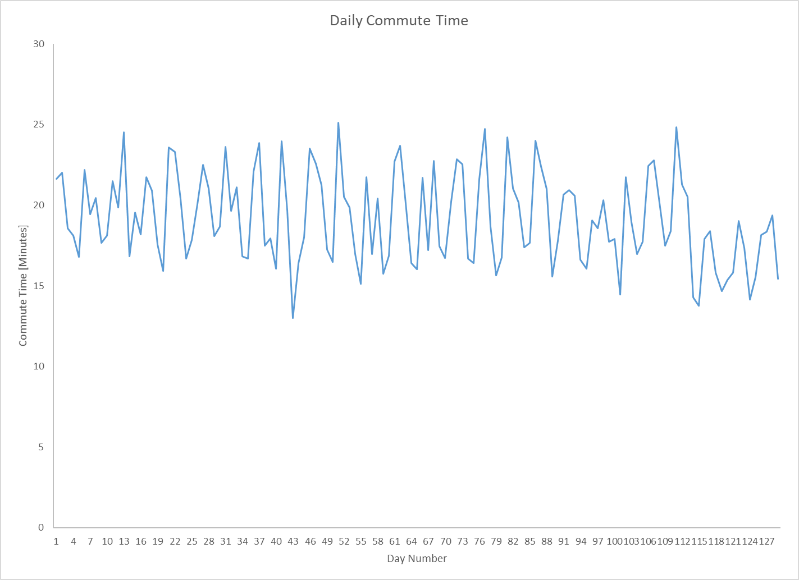
Line chart
Plots y vs. x values as points but only includes x values that are present in the data. Points can be connected by lines.
Good for:
Seeing trends or patterns over time
Continuous y values with x values that are related left to right
Not so good for:
When x values are missing

Slide 15
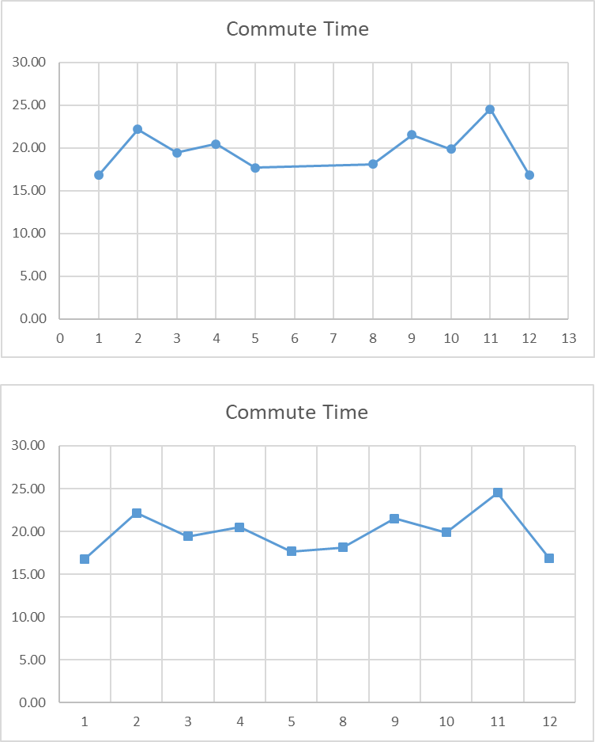
Scatter plot vs. line chart
At first, a scatter plot and line chart appear to be the same. Be careful, they are different and that difference can cause major differences in interpreting the data.
Day | Commute Time
1 | 16.80
2 | 22.18
3 | 19.44
4 | 20.47
5 | 17.68
8 | 18.11
9 | 21.51
10 | 19.87
11 | 24.53
12 | 16.83
Scatter plot
Includes the numbers between the minimum and maximum on the x-axis even though the data set is missing 6 and 7.
Note that days 6 and 7 are missing from the data.
Line chart
Only includes the x values that are in the data set.
The chart skips 6 and 7 on the x-axis.

Slide 16
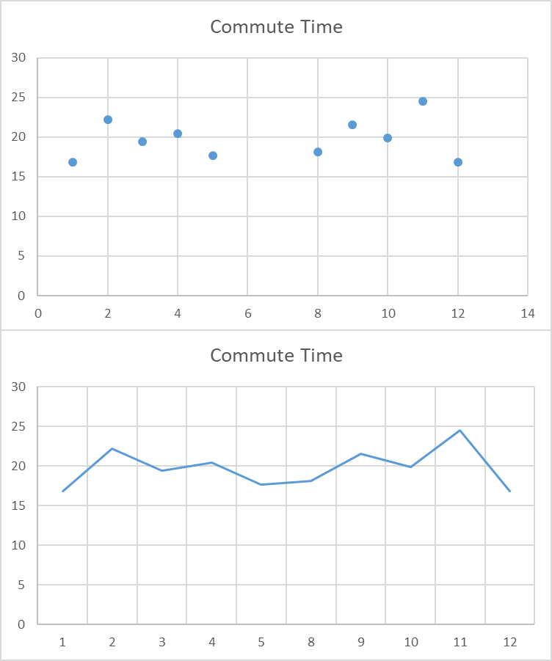
Scatter plot vs. line chart
At first, a scatter plot and line chart appear to be the same. Be careful, they are different and that difference can cause major differences in interpreting the data.
Day | Commute Time
1 | 16.80
2 | 22.18
3 | 19.44
4 | 20.47
5 | 17.68
8 | 18.11
9 | 21.51
10 | 19.87
11 | 24.53
12 | 16.83
Scatter plot
Often does not connect the points with lines. The points can be used to look for patterns where connecting lines may be distracting, e.g., looking for groups or clusters of points.
Line chart
Usually has lines and sometimes does not show the specific points.

Slide 17
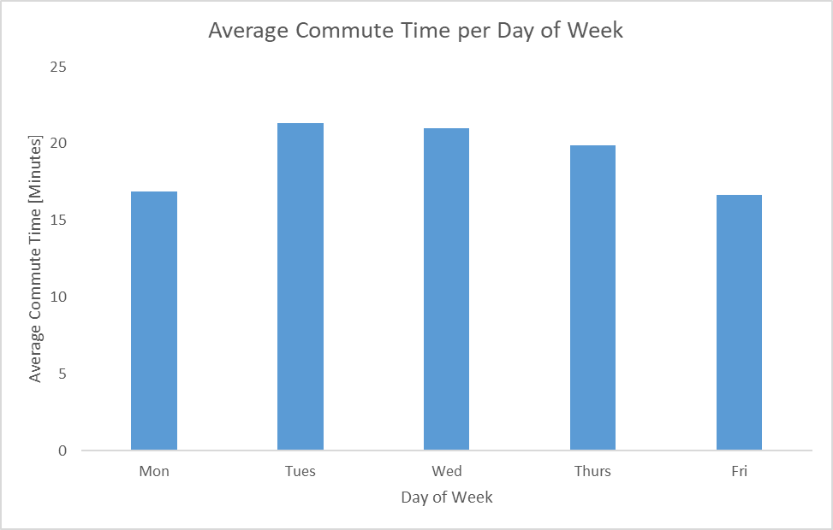
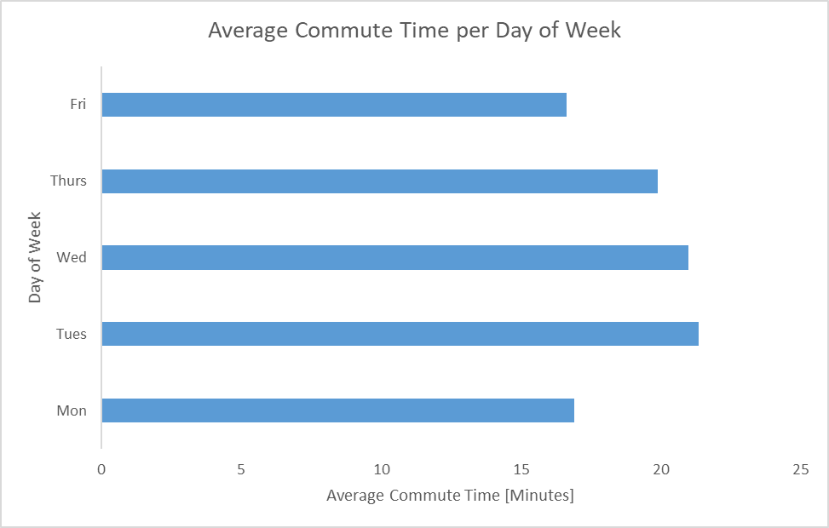
Bar chart
Represents data with vertical or horizontal bars. The size of the bar represents the magnitude of the value.
Vertical bar chart
Good for:
Categorical data
Making comparisons
Can be sorted by height to show a “Top 5” view
Not so good for:
Continuous values
Large number of categories, label text gets very small; may need to group the smaller categories into an “other” group
Horizontal bar chart

Slide 18
Histogram
A histogram creates “bins” (ranges of values) and shows how many data points are in each bin based on the height of the bin’s bar. In the example below, there are about 6 data points in the bin representing the smallest commute times (12.98 minutes to 14.98 minutes).
Good for:
Showing the “shape” of the data, that is, how the data are distributed
Not so good for:
Data that is related to time (see scatter plots or line charts)
Comparing groups of data (see box plots)

Slide 19
Box plot
A box plot, sometimes called a box and whisker plot, shows the spread of data for multiple categories. It is kind of like showing a few “squished” histograms on one page.
Good for:
Continuous data that can be grouped
Comparing categories of data based on its variation (spread)
Not so good for:
Continuous values with no natural grouping
Large number of categories, label text gets very small; may need to group the smaller categories into an “other” group

Slide 20
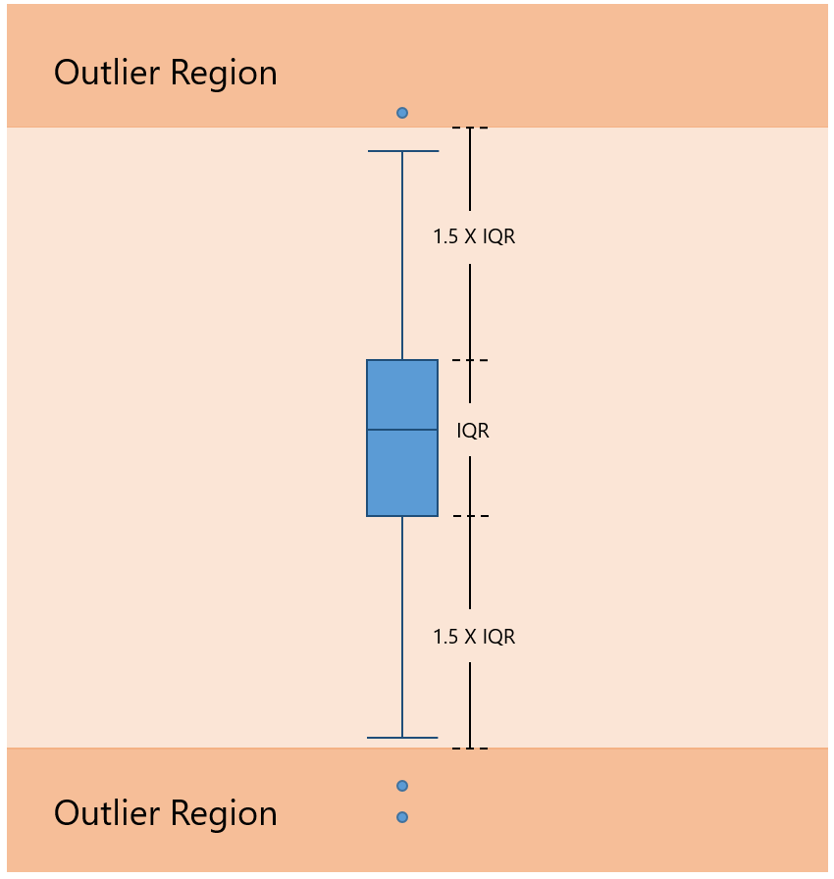
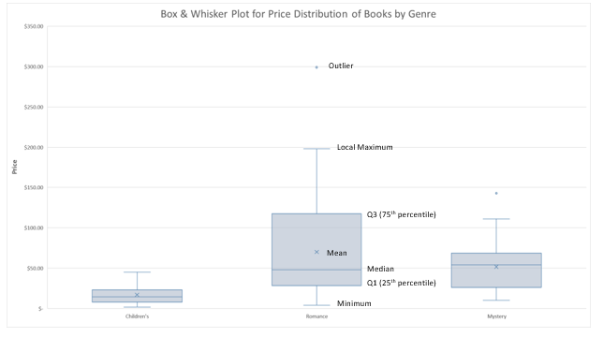
Deciphering a box plot
The objects (boxes, whiskers, markers, etc.) on a box plot can vary slightly depending on the software and the creator of the plot.
Be sure you know how to interpret the box plot you are examining!
The guidelines here are from the Microsoft blog and represent the typical meanings.
Source: https://www.microsoft.com/en-us/microsoft-365/blog/2015/08/18/visualize-statistics-with-histogram-pareto-and-box-and-whisker-charts/

Slide 21
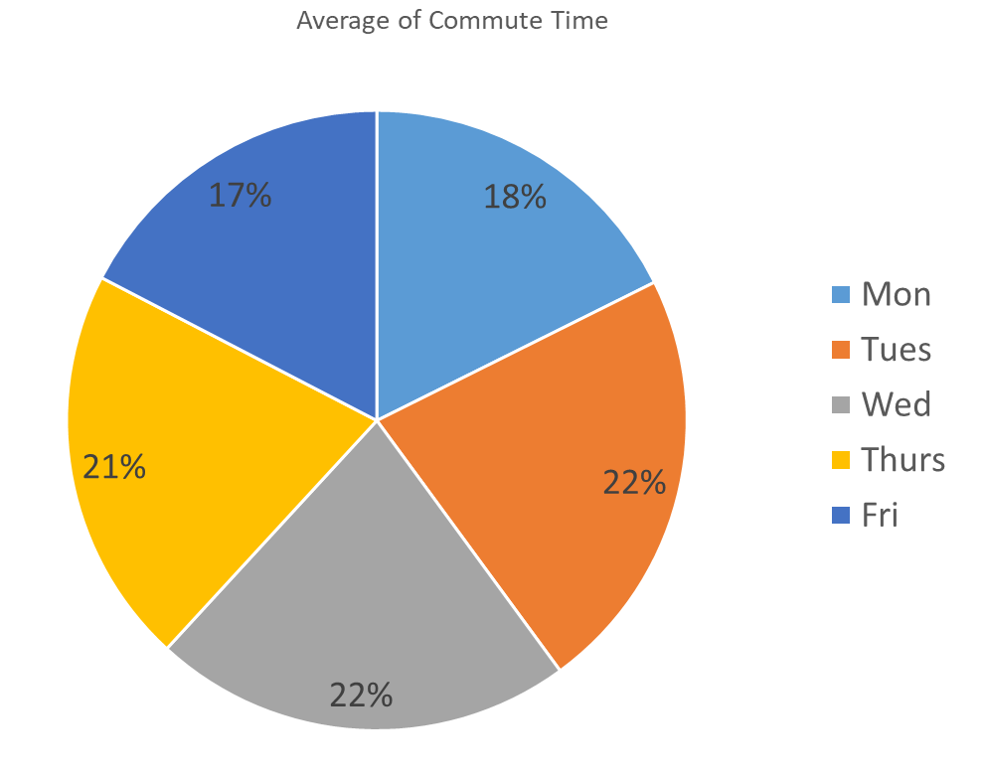
Pie chart
A pie chart represents the data as “slices” of a circle, or “pie.”
Good for:
Sometimes showing percentage data that adds up to 100%
Not so good for:
Most uses
Bar charts are often a better choice: Humans better at differentiating bar heights vs. differentiating angles (like pie slice sizes)
Use pie charts sparingly. I will not say to never use them. I will say use them almost never. Never use them if presenting to me. ☺

Slide 22
Heat map: Multicolor
A heat map represents values with colors or intensities. Sometimes heat maps can be shaped like a geographical map to represent a country or region.
 | Week Number (Calendar time increasing left to right)
Day of Week | 1 | 2 | 3 | 4 | 5 | 6 | 7 | 8 | 9 | 10 | 11 | 12 | 13 | 14 | 15 | 16 | 17 | 18 | 19 | 20 | 21 | 22 | 23 | 24 | 25 | 26
Mon
Tues
Wed
Thurs
Fri
Legend: Red = max; Green = min
Good for:
Showing three dimensions: x & y axis plus the color intensity
Represent geographical data
Recognizing patterns
Not so good for:
Showing precise values (numeric values can be displayed to help)
Two dimensional data: another chart type would be better

Slide 23
Heat map: Same color with varying intensity
A heat map represents values with colors or intensities. Sometimes heat maps can be shaped like a geographical map to represent a country or region.
Remember some people cannot see colors!
 | Week Number (Calendar time increasing left to right)
Day of Week | 1 | 2 | 3 | 4 | 5 | 6 | 7 | 8 | 9 | 10 | 11 | 12 | 13 | 14 | 15 | 16 | 17 | 18 | 19 | 20 | 21 | 22 | 23 | 24 | 25 | 26
Mon
Tues
Wed
Thurs
Fri
Legend: Dark = max; Light = min
Good for:
Showing three dimensions: x & y axis plus the color intensity
Represent geographical data
Recognizing patterns
Not so good for:
Showing precise values (numeric values can be displayed to help)
Two dimensional data: another chart type would be better

Slide 24
“Do & Don’t” lists
Do
Use the appropriate chart type
Use consistent chart types
Avoid distortion
Use consistent ranges when comparing charts
Keep it simple (avoid 3D effects)
Don’t
Forget labels
Overuse colors
Skip values on the x-axis
Make font size too small
Get too fancy

Slide 25
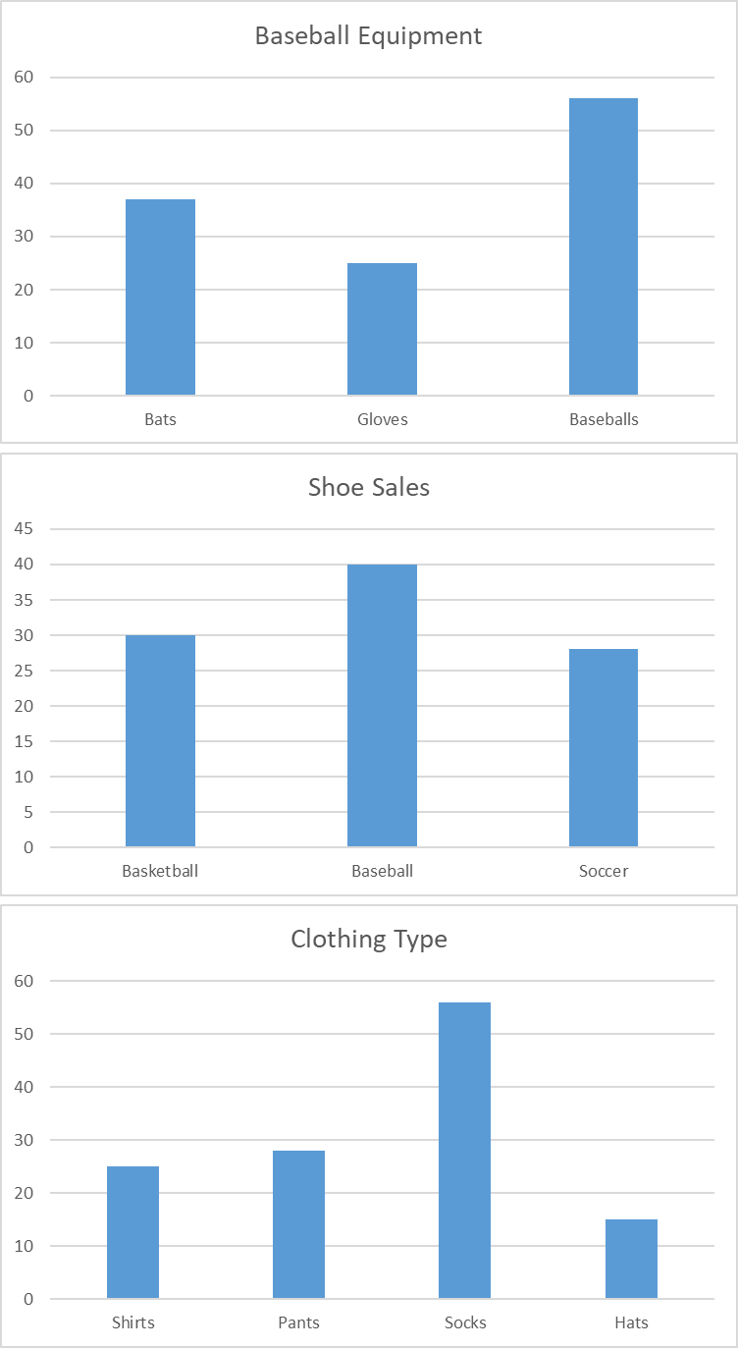
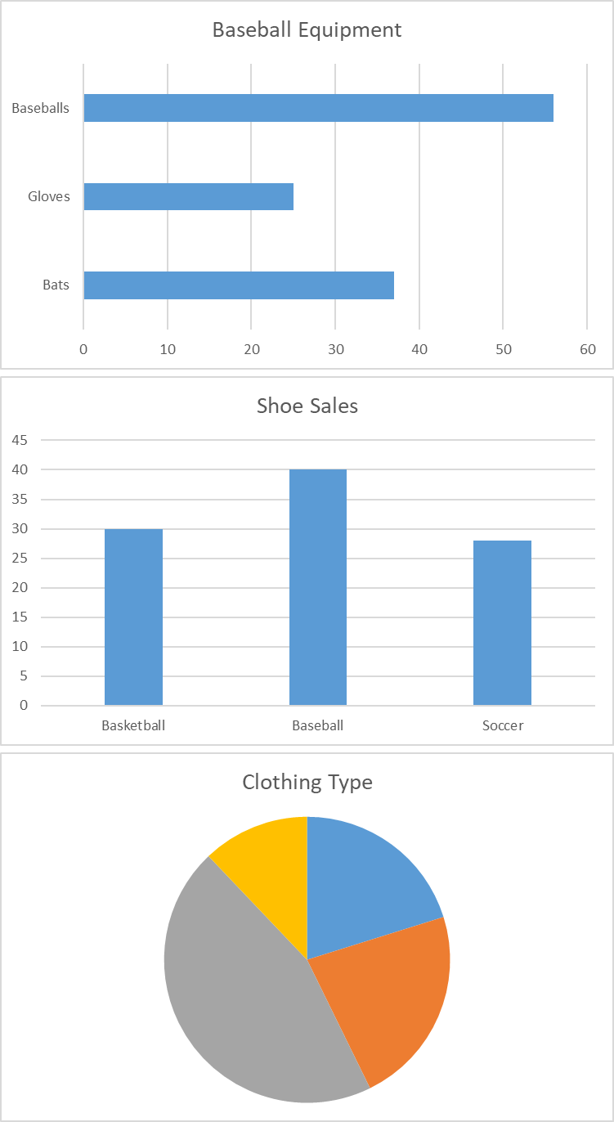
Do: Use consistent chart types
Human’s have to “recalibrate” each time they see a new chart type. The group on the left is much easier to read because no recalibration is needed when moving from chart to chart.
Better: Use consistent chart type
Worse: Vary chart types

Slide 26
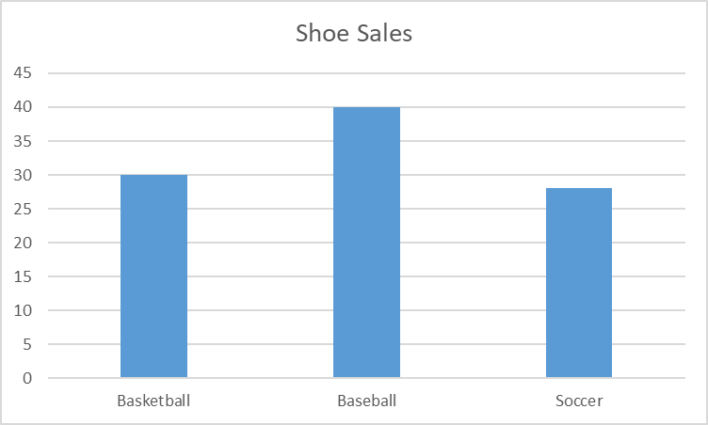
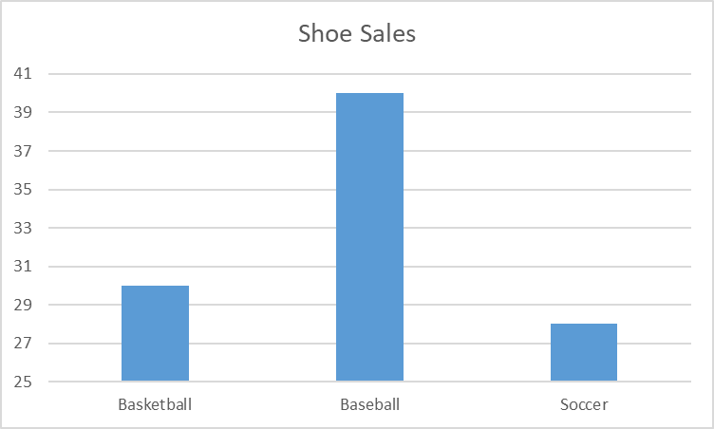
Do: Avoid distortion
For bar charts, be careful to have the vertical (y-axis) start at zero. The charts below show the same data but send very different messages.
Good: Start y-axis at zero
Unacceptable: Start y-axis at non-zero value

Slide 27
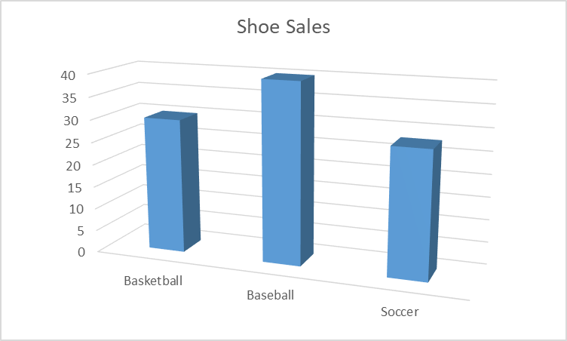
Do: Keep it simple
Most of the time, “fancy” features distract the viewer from the message.
Good: Nice and simple
Bad: 3D effect makes it difficult to read

Slide 28
Software
Software for creating visualizations comes in many shapes and sizes with varying ease of use and features.
Software | Brief Description
Microsoft Excel (used for these slides) | Spreadsheet
Tableau | Dashboard software
Spotfire | Dashboard software
R | Statistical software
Matlab | Matrix math
Python | Programming language

Slide 29
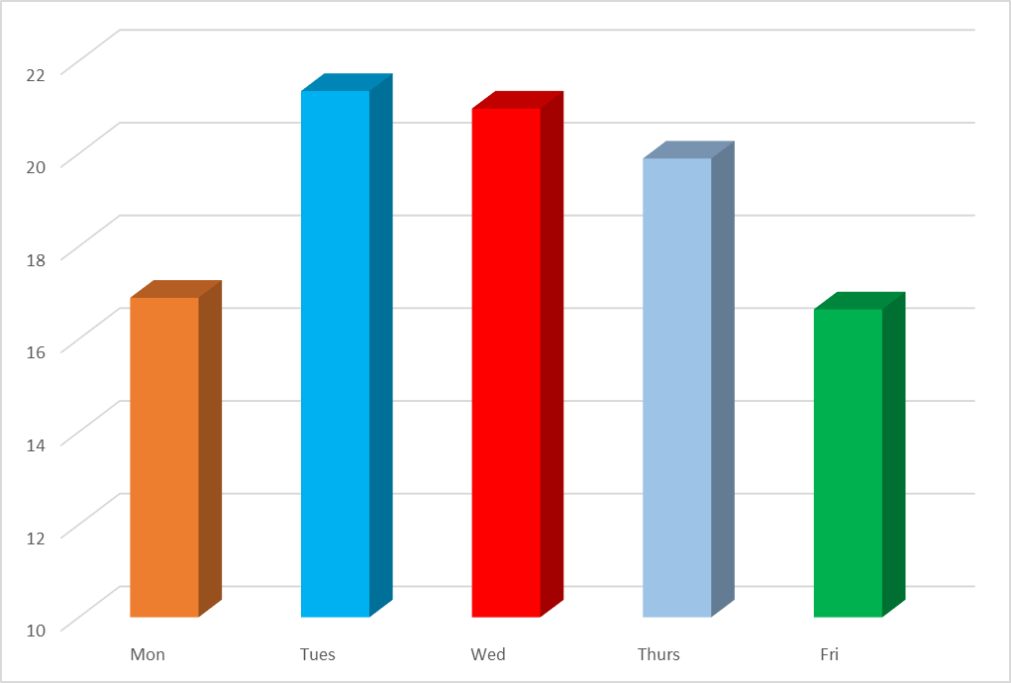
What is wrong with this chart…

Slide 30
Example: Analyzing Lego set prices
This example uses a relatively small data set to illustrate the various visualizations and the reasons behind each one.
RowNum | Theme | NumOfPieces | NumOfBigFigs | NumOfMiniFigs | Price[$] | Price per Piece
1 | Batman | 2526 | 0 | 9 | $ 270 | $ 0.11
2 | Batman | 306 | 0 | 3 | $ 30 | $ 0.10
3 | Batman | 224 | 0 | 3 | $ 20 | $ 0.09
4 | Batman | 517 | 0 | 5 | $ 60 | $ 0.12
5 | Batman | 1037 | 0 | 8 | $ 120 | $ 0.12
6 | Batman | 92 | 0 | 2 | $ 13 | $ 0.14
7 | Batman | 460 | 1 | 3 | $ 70 | $ 0.15
8 | Marvel | 523 | 1 | 4 | $ 60 | $ 0.11
9 | Marvel | 807 | 0 | 6 | $ 80 | $ 0.10
10 | Marvel | 287 | 0 | 3 | $ 30 | $ 0.10
11 | Marvel | 179 | 0 | 3 | $ 20 | $ 0.11
12 | Ninjago | 231 | 0 | 3 | $ 20 | $ 0.09
13 | Ninjago | 221 | 0 | 2 | $ 20 | $ 0.09
14 | Ninjago | 294 | 0 | 3 | $ 30 | $ 0.10
15 | Ninjago | 450 | 1 | 4 | $ 50 | $ 0.11
16 | Ninjago | 350 | 0 | 2 | $ 30 | $ 0.09
17 | Ninjago | 98 | 0 | 2 | $ 10 | $ 0.10
18 | Star Wars | 1414 | 0 | 7 | $ 170 | $ 0.12
19 | Star Wars | 102 | 0 | 4 | $ 15 | $ 0.15
20 | Star Wars | 519 | 0 | 4 | $ 70 | $ 0.13
21 | Star Wars | 4016 | 0 | 23 | $ 500 | $ 0.12
22 | Star Wars | 345 | 0 | 2 | $ 30 | $ 0.09

Slide 31
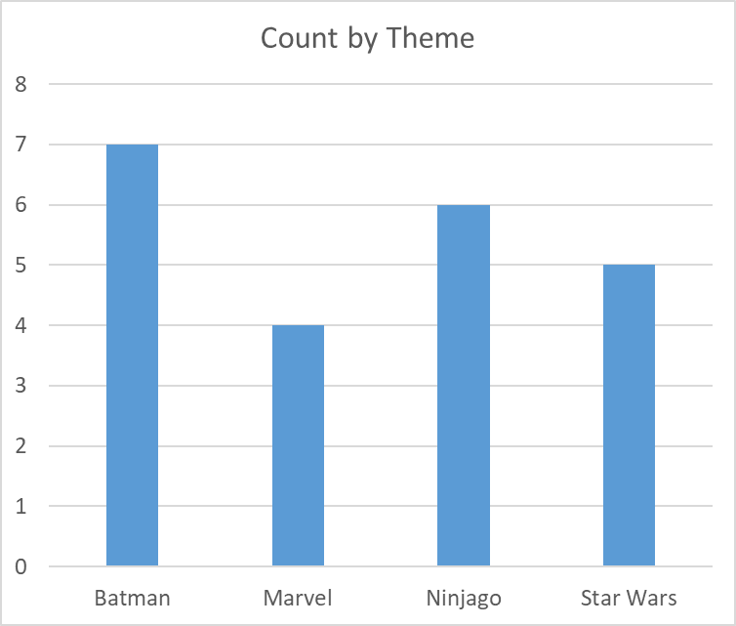
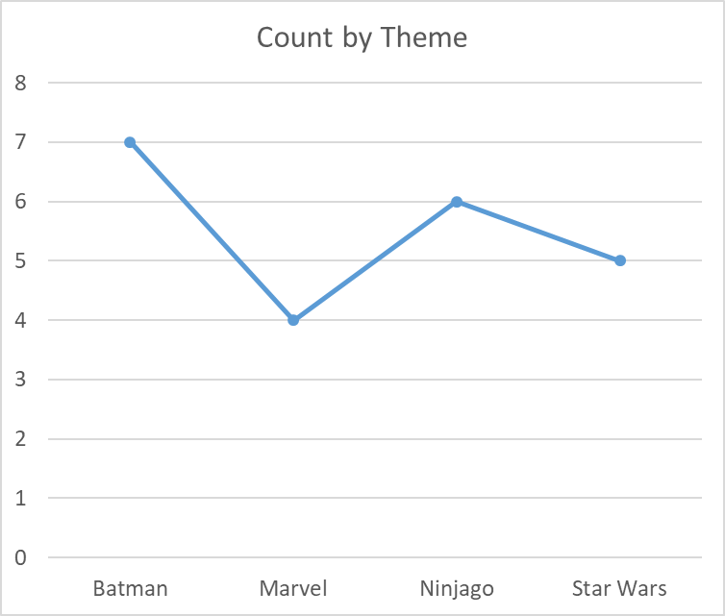
Lego sets: Count of sets by theme in our data
Which chart is better? Why?

Slide 32
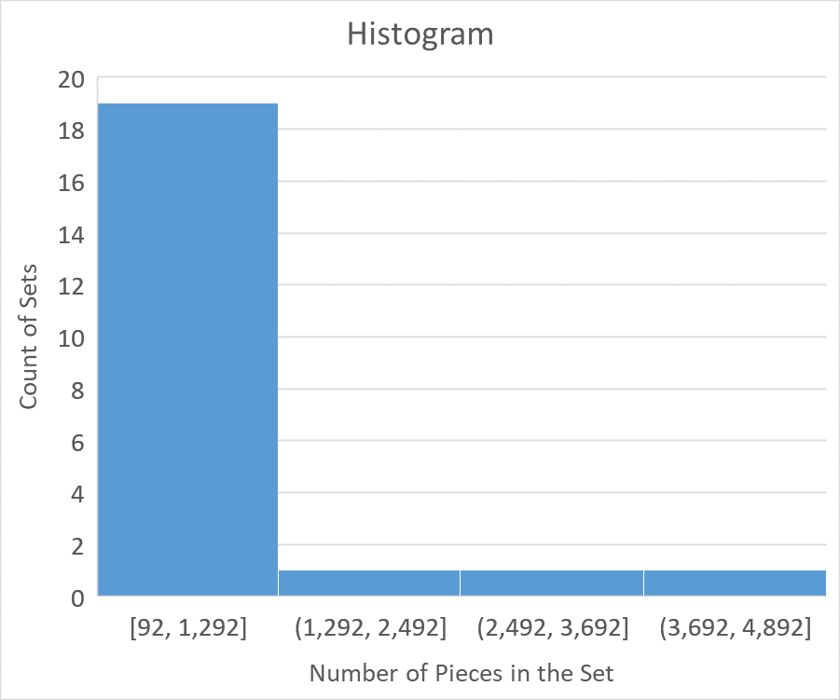
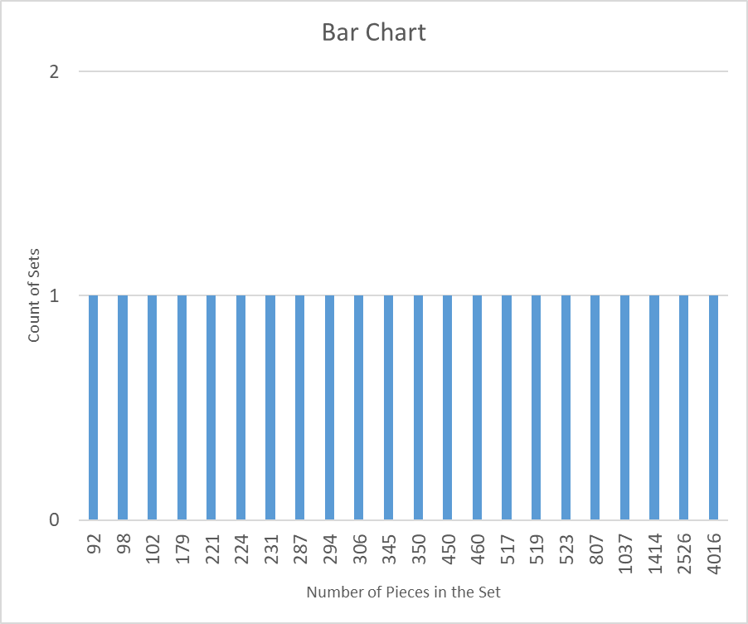
Lego sets: Number of pieces per set
Same data on different chart types
Why do they look so different?
Which one is more useful?

Slide 33
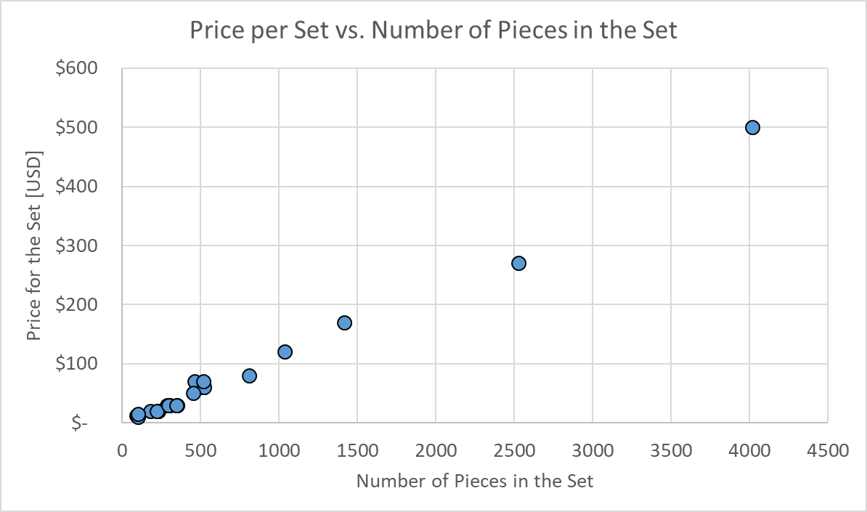
Lego sets: Price vs. Number of pieces
Is there a relationship between the number of pieces and the price of the set?
What kind of plot is this?

Slide 34
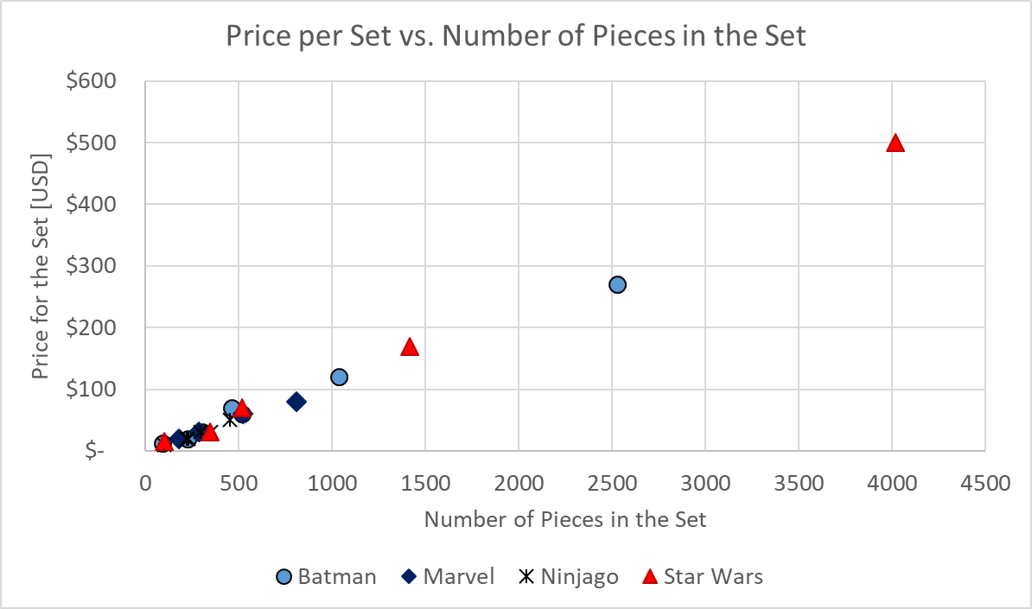
Lego sets: Price vs. Number of pieces
What if we look at the theme as a “third dimension?”

Slide 35
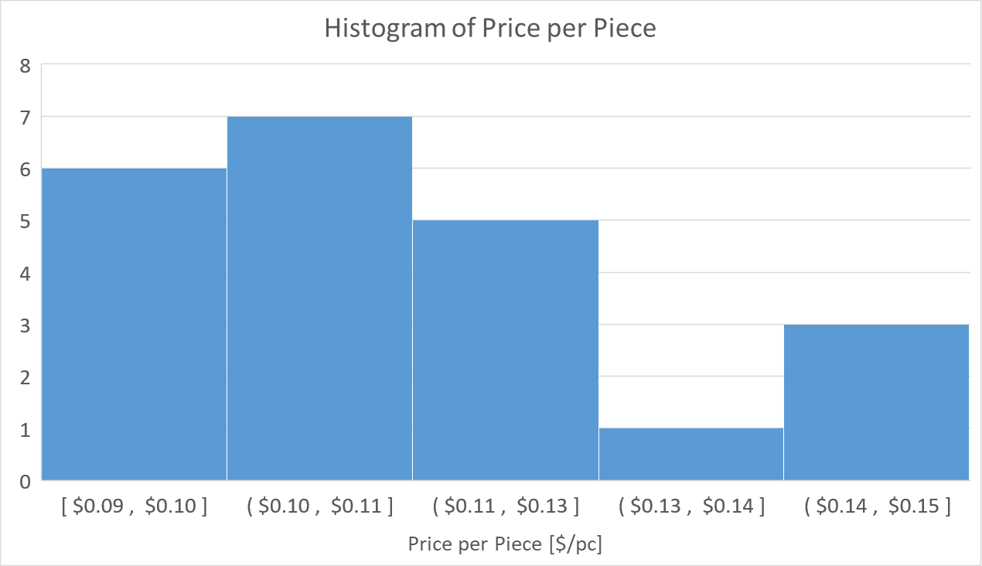
Lego sets: Price per piece
Anything interesting about the shape?

Slide 36
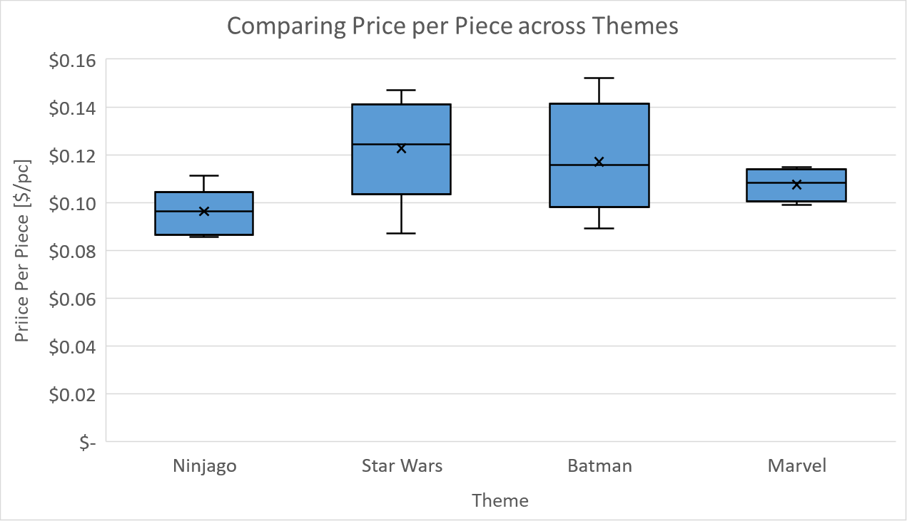
Lego sets: Price per piece across themes
Box plot shows the spread of price/piece across themes
Anything interesting? Any explanation?

Slide 37
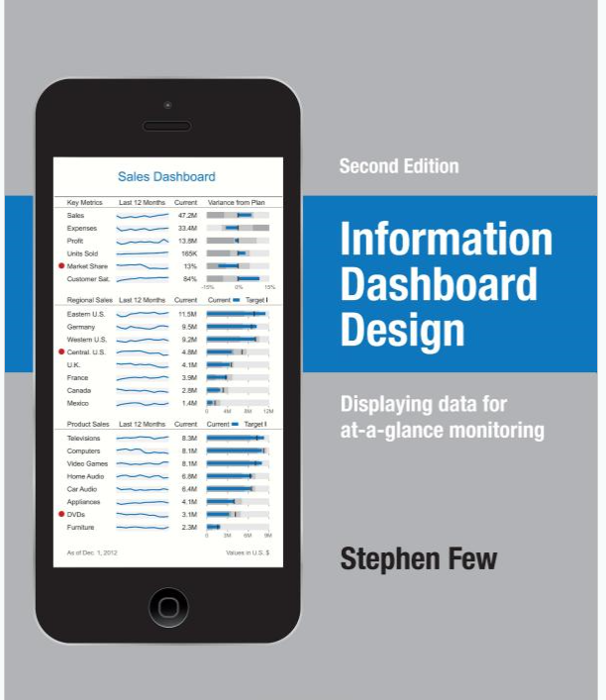
Reference
Information Dashboard Design: Displaying Data for At-a-Glance Monitoring Second Edition
by Stephen Few

